Slide 1



Supply Chain Management and its
Role in Operations Management
Operations and Supply Chain Management
MGT6046
Dr Emilia Vann Yaroson
Notes:
Welcome. This is a two-hour session: about 110 minutes of teaching and activity with a 10-minute break at the one-hour mark. There is a Wooclap activity roughly every 20 minutes, so ask students to open Wooclap on their phones now. The aim is to position supply chain management as a core part of operations management rather than a separate subject.

Slide 2

Module Outline
Wk | Starts | 4D | Lecture | Tutorial
1 | 28 Sep 2026 | Develop | Operations and Supply Chain Management Foundations Operations strategy, performance objectives, interdependencies and customer value. | No tutorial
2 | 5 Oct 2026 | Develop | Capacity, Utilisation, Efficiency and Little’s Law Design and effective capacity, utilisation, efficiency, WIP, throughput, flow time and demand–capacity relationships. | No tutorial
3 | 12 Oct 2026 | Design | Productivity, Throughput and Service Failure Analysis Productivity, throughput efficiency, waiting, delays, capacity–demand mismatch and service failure, using operational and ERP data. | Tutorial 1: applying Week 2 (capacity, utilisation, efficiency, Little’s Law, WIP, servers, strategy)
4 | 19 Oct 2026 | Design | Designing Operations: Theory of Constraints, Line Balancing, ERP and Digitalisation Bottlenecks, cycle time, line balancing, ERP, automation, AI, IoT and real-time visibility. | No tutorial
5 | 26 Oct 2026 | Delivering operations | Supply Chain Management Disruptions, resilience and sustainability. | Tutorial 2: applying Week 4 (TOC, bottlenecks, idle time, balancing loss, productivity, ERP data)
6 | 2 Nov 2026 | Deliver | Make-or-Buy Decisions and Break-even Analysis | No tutorial
2

Slide 3

JOIN NOW
Join today’s Wooclap
Get your phone out: we use it throughout the session.
1 Scan the QR code
2 or go to app.wooclap.com
3 and enter the event code
JXRSLXH
Scan to join
3
Notes:
Show this while students arrive and settle. Everyone should join before the opening puzzle, because its four questions run in Wooclap. Event code JXRSLXH. A smaller QR code also sits in the top-right corner of every Wooclap question slide for latecomers.

Slide 4
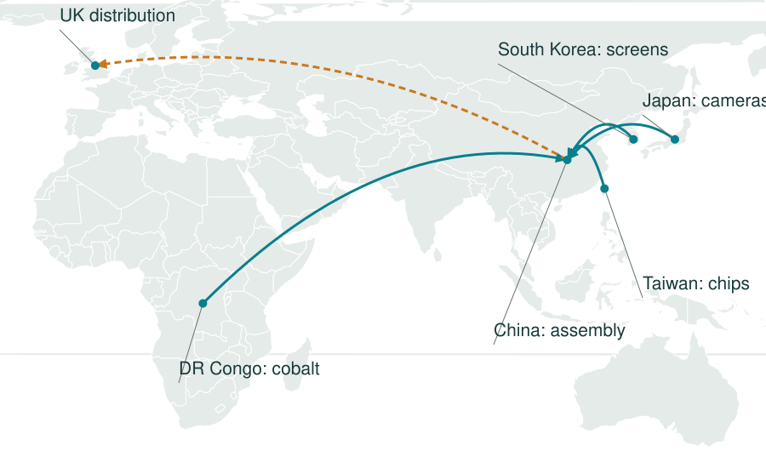

Supply chains are all around us:
The global network behind your mobile phone
Separate input routes converge at assembly
Solid teal: inputs to assembly Dashed amber: finished phones to the UK
Illustrative routes. Cobalt passes through refining and battery production. Lines show connections, not transport paths.
Notes:
Illustrative supply network, not a traced manufacturer supply chain. Component origins vary across models. The cobalt route includes intermediate refining and battery manufacturing, which the map omits for clarity. Material and component routes converge at assembly in China, with finished phones moving to UK distribution. Ask which missing component could delay assembly and whether good supplier performance guarantees availability of finished phones. Map geometry: Natural Earth via world-atlas countries-110m. Phone picture supplied by the user.

Slide 5
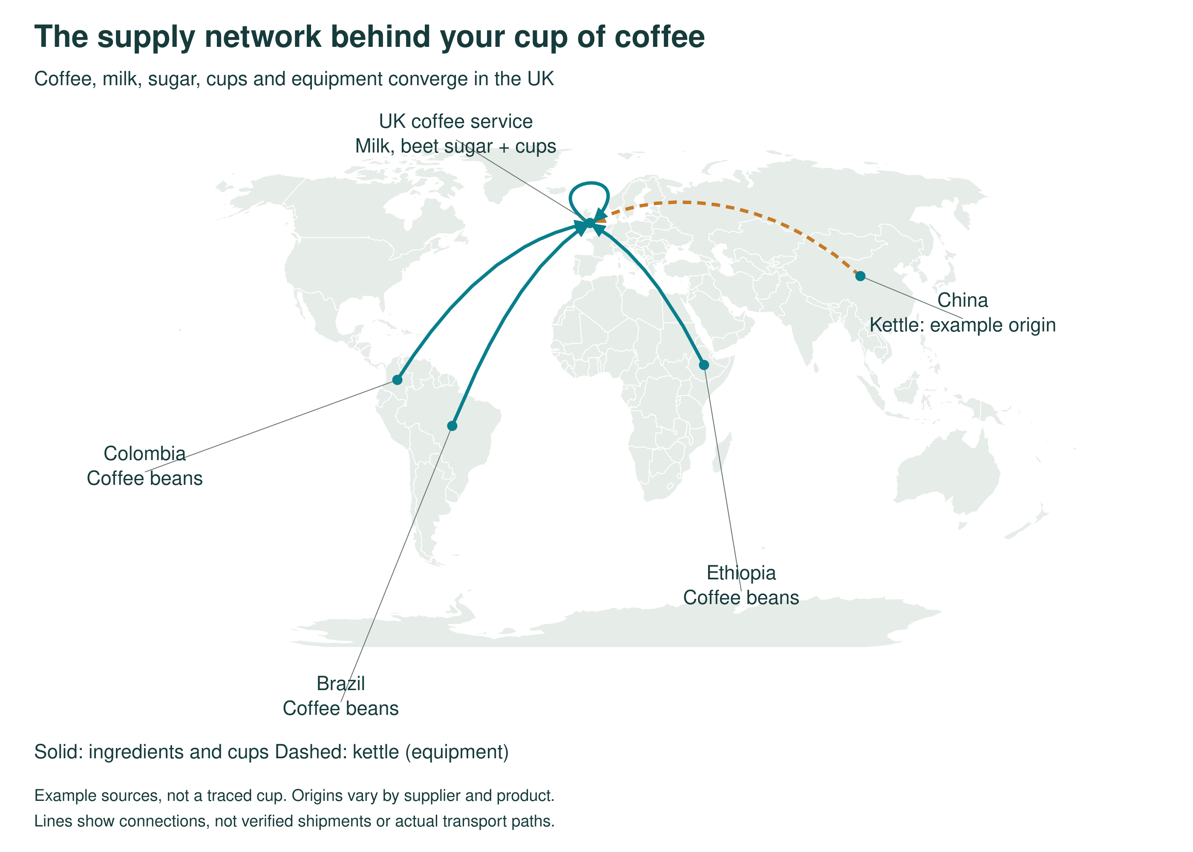
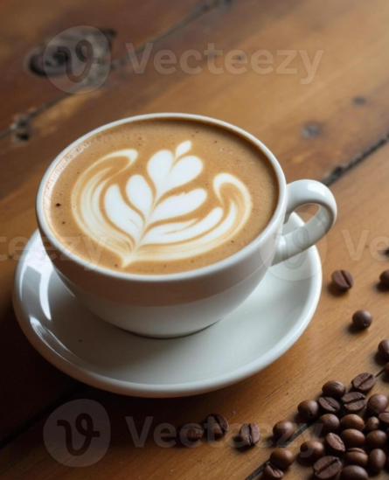
Supply chains are all around us:
Join: JXRSLXH
Notes:
Illustrative supply network, not a traced manufacturer supply chain. Component origins vary across models. The cobalt route includes intermediate refining and battery manufacturing, which the map omits for clarity. Material and component routes converge at assembly in China, with finished phones moving to UK distribution. Ask which missing component could delay assembly and whether good supplier performance guarantees availability of finished phones. Map geometry: Natural Earth via world-atlas countries-110m. Phone picture supplied by the user.

Slide 6
How Does a Latte Become Available?
Coffee growers
Roaster
Dairy
Cup maker
Warehouse and van
Café
You
A supply chain
connects the organisations and activities that fulfil a customer’s need.
Supply chain management
coordinates those activities and the flows of materials, information and money across organisations.
6
Notes:
60 seconds. Link the café to growers, processors, dairy, packaging producers, warehouses and transport providers. Materials move towards the café and customer. Orders, demand data and delivery updates move between partners. Payments connect the commercial transactions. This is an introductory teaching definition.

Slide 7
A perfect operation can still fail its customers.
Today we explore this argument. What happens when…
demand doubles?
Part 2 · the bullwhip effect
supply runs short and every actor protects itself?
Part 4 · the case
the trade-offs
Part 3 · disruption and resilience sustainability
7
Notes:
60 seconds. State the opening argument plainly: the operation (barista, machine, process) was perfect, yet the customer left without a latte, because performance depends on the supply chain around the operation. Every part of today’s session tests this argument: demand amplification (the bullwhip effect), disruption and resilience, and a case where supply is short. We return to the café at the end, before the takeaways. Optional extension: ask whether keeping more stock could create waste, particularly for milk. Core puzzle activity about 9–11 minutes depending on discussion.

Slide 8
Learning Outcomes
By the end of the session, you should be able to:
1
Explain how operations management and supply chain management connect
2
Describe the key supply chain decisions and how they shape operations performance
3
Critically evaluate competing explanations of supply chain failure, including the bullwhip effect
4
Analyse trade-offs between cost, responsiveness, resilience and sustainability, and who bears them
8
Notes:
Read through the four outcomes. Outcome 3 is the intellectual core: students should leave able to argue, with evidence, why supply chains fail, rather than just describe how they work. Outcome 4 runs through the case and the Wooclap votes.

Slide 9
What is a Supply Chain?
A network of organisations involved, through upstream and downstream linkages, in the processes and activities that produce value for the ultimate consumer.
Three or more entities directly involved in the upstream and downstream flows of products, services, finances and information from a source to a customer.
Christopher (1992)
Mentzer et al. (2001)
Supply chain management involves getting the right product/service to customers at the right time and the right price.
9
Notes:
Two classic definitions. Christopher stresses value for the end consumer; Mentzer stresses the flows and that a supply chain needs at least three parties. The bottom box gives the management definition: coordination across organisational boundaries, which is exactly what traditional operations management did inside one firm.
MSc DISCUSSION (pairs or think-alone, then take two or three answers): Christopher calls it a network, yet we still say 'chain'. Does the metaphor matter? A chain implies one linear owner and one direction of flow; a network implies many actors with competing interests. Which definition would a supplier in Ghana or Bangladesh write? And does 'right product, right time, right price' reduce SCM to logistics?

Slide 10
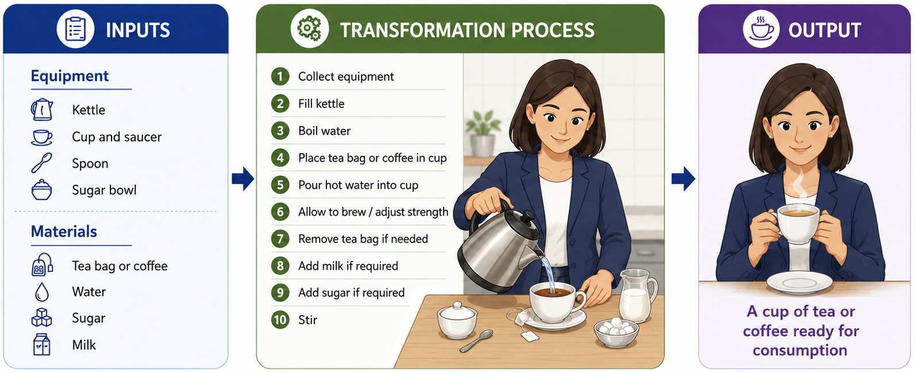
Recall: Let’s Make a Cup of Tea or Coffee
Supply chain: sourcing the inputs
Supply chain: delivering the output
Where do the inputs come from? Coffee from Brazil or Colombia, tea from Kenya or India, milk from a UK dairy farm; kettle and cup made overseas.
How does the output reach the customer? Handed to a guest at home; in a café, served at the counter, collected from a mobile order or brought by a delivery rider.
Figure from Week 1, Operations and Supply Chain Management
10
Notes:
Recall the Week 1 activity: let’s make a cup of tea or coffee. The green middle panel is classic operations management: ten simple steps the person controls. The two panels highlighted in coral are the supply chain. Sourcing the inputs: none of the equipment or materials were made in this kitchen. Coffee or tea has travelled thousands of miles, the milk a few dozen, and the kettle was probably made overseas. Delivering the output: at home it is handed to a guest, but in a café it might be collected from a mobile order or brought by a delivery rider. Ask: if the milk runs out or the coffee price spikes, can a perfect ten-step process still deliver the output? This links back to the iced oat latte in Wooclap 1.

Slide 11
OM and SCM: One System, Two Lenses
OM lens: zoom in inside one operation
SCM lens: zoom out across the whole network
Farm
Warehouse
Inputs
Transform
Outputs
The operation
You
Supplier
Store
Dimension | Operations management | Supply chain management
Unit of analysis | One operation and its processes | The network of linked operations
Main question | How do we transform inputs efficiently? | How do we coordinate flows across firms?
Typical decisions | Process design, layout, capacity, quality | Sourcing, network design, inventory, logistics
Control | Direct authority | Influence, contracts and relationships
Success measure | Internal performance objectives | End-customer value across the chain
Supply chain management is operations management extended beyond the factory gate: firms compete as supply chains, not only as single firms Christopher (2001).
11
Notes:
Use the picture first: the same operation seen through two lenses. The OM lens zooms in on the transformation process inside one operation; the SCM lens zooms out to see that operation as one node in a network of farms, suppliers, warehouses, stores and customers. Then use the table: the key shift is in the “Control” row. Inside the firm, managers can instruct; across the chain they must persuade, contract and build relationships. That is why governance and power, covered in Lecture 1, matter so much. Close Part 1 by asking whether students agree that firms now compete as supply chains, not as single firms.
MSc DISCUSSION (pairs or think-alone, then take two or three answers): If 'supply chains compete, not firms' (Christopher), who actually competes? Foxconn assembles for rival brands, and Maersk ships for everyone. Can a firm belong to several competing chains, and what does that do to trust and information sharing?

Slide 12
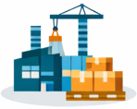

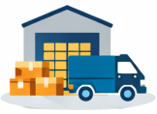
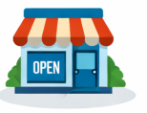

Three flows connect the supply chain
Products move towards customers. Information connects every stage.
Supplier
Manufacturer
Distributor
Retailer
Customer
MATERIALS
Components and finished products
INFORMATION
Orders, forecasts, stock levels and delivery updates
FINANCE
Customer payments move back towards suppliers
Returns can move upstream. Refunds can move downstream.
What happens to the other flows if a customer changes an order?
Notes:
Explain downstream as movement towards the final customer and upstream as movement towards suppliers. Materials usually move downstream, while returns, recycling and repair create reverse flows. Information moves both ways: orders and demand signals upstream, and availability, confirmations and tracking downstream. Payments usually move upstream, while refunds and credits can move downstream. Ask students to apply these flows to a coffee shop: beans and cups, an order or stock update, then payment. Follow-up question: when a customer changes an order, how must material allocation, information and payment be coordinated?

Slide 13
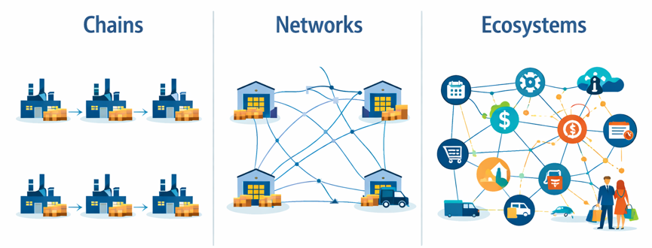
Supply chains: scope and structure
Structure: how do the participants connect?
Scope: how far does our view extend?
DIRECT
EXTENDED
ULTIMATE
Organisation, immediate
supplier and customer
Also includes suppliers’ suppliers
and customers’ customers
All relevant upstream and downstream
participants and supporting providers
Scope framework: adapted from Mentzer et al. (2001), Journal of Business Logistics, 22(2), 1–25.
Notes:
Reference: Mentzer, J.T., DeWitt, W., Keebler, J.S., Min, S., Nix, N.W., Smith, C.D. and Zacharia, Z.G. (2001). Defining supply chain management. Journal of Business Logistics, 22(2), pp. 1–25. https://doi.org/10.1002/j.2158-1592.2001.tb00001.x . This citation supports the direct, extended and ultimate scope framework. The chains/networks/ecosystems illustration was supplied by the user; its original source has not been established. Combines the concepts from the two supplied figures. Scope is the boundary of analysis relative to a focal organisation: direct includes its immediate supplier and immediate customer; extended includes their immediate suppliers and customers; ultimate includes all organisations involved in upstream and downstream flows, including supporting providers such as finance, logistics and market research. Structure is how actors relate: a chain simplifies sequential links, a network recognises multiple interacting connections, and an ecosystem broadens attention to complementary actors and institutions. Do not treat direct=chain, extended=network, ultimate=ecosystem as exact equivalences or necessary evolutionary stages. Use the mobile phone example to ask which actors disappear when the boundary is drawn narrowly.

Slide 14

The Supply Network Perspective
Setting an operation in the context of all the other operations it interacts with its suppliers and its customers.
2nd-tier supplier
1st-tier supplier
The operation
1st-tier customer
2nd-tier customer
What do organisations choose? | What this means
Network design | Which suppliers to use, where to operate and which activities to outsource.
Visibility | How far upstream and downstream they investigate and trace connections.
Management involvement | Which relationships they actively coordinate, monitor or influence.
Source: adapted from Slack, Brandon-Jones and Burgess (2022)
14
Join: JXRSLXH
Notes:
Introduce tiers. Most firms manage their immediate network well and the total network poorly; risk and sustainability problems tend to sit at tier 2 and beyond, which is why visibility matters so much later in the session.

Slide 15
Three Strategic Network Design Decisions
1
Configuration: what shape, and how much do we own?
Number of tiers and suppliers, disintermediation, and the do-or-buy (vertical integration) decision
2
Location: where should each part sit?
Offshore, nearshore or local: labour cost, proximity to customers, risk, policy incentives and emissions
3
Capacity: how much should each factory or site process
Long-term capacity in plants and warehouses: lead, lag or match demand
All three rely on demand forecasts, are expensive to reverse, and set the context for every process decision inside the operation.
15
Notes:
This connects to the Week 5 network design lecture. Stress that these are the most strategic operations decisions because they lock in cost structure and risk exposure for years. Ask: which of the three did the pandemic and recent shipping disruptions force firms to revisit? Most students will say location.
MSc DISCUSSION (pairs or think-alone, then take two or three answers): Network design assumes forecasts that hold for ten years or more. In a world of wars, tariffs and pandemics, can long-term design still be optimised, or should firms design for optionality: paying now for the right to switch later (a real-options view)?

Slide 16
Make or Buy? Outsourcing and Vertical Integration
Objective | Make in-house | Buy it in (outsource) | Examples
Quality | Easier to trace problems | Specialist may have better capability | Rolex
Speed | Synchronised schedules | Speed depends on the contract | Toyota
Dependability | Internal priority and communication | Delivery promises may be harder to enforce | Amazon
Flexibility | Limited by own capacity and skills | Access to a wider range of capabilities | Zara
Cost | No supplier margin, but capital tied up | Economies of scale, but supplier takes a margin | Aldi, Lidl
Source: adapted from Slack, Brandon-Jones and Burgess (2022)
16
Notes:
Use the performance objectives from earlier to structure the outsourcing decision. Examples: banks outsourcing credit checks, bakers not growing wheat, business process outsourcing of payroll. Note that outsourcing transfers the activity but not the reputational risk, which links to the sustainability lecture.

Slide 17
Sourcing: How Many Suppliers, and How Close?
Single sourcing
Multiple sourcing
For: closer relationship, consistent quality, joint improvement, scale discounts
For: competition on price, back-up if one fails, wider capability
Against: vulnerable to one failure, weaker bargaining power, supplier lock-in
Against: less commitment, harder to coordinate, quality varies, small volumes each
Transactional
Partnership
Relationships range from arm’s-length, price-based buying to long-term partnerships with shared information, joint planning and shared risk.
Source: adapted from Slack, Brandon-Jones and Burgess (2022)
17
Notes:
Single versus multiple sourcing is the classic trade-off between closeness and security. Many firms now use dual sourcing for critical parts as a compromise. Set up the next activity: students will choose between three suppliers and should use these arguments.
MSc DISCUSSION (pairs or think-alone, then take two or three answers): Toyota's close single-source partnerships are a celebrated strength, yet its recovery from the 1997 Aisin brake-valve fire came from the wider supplier network, not one partner. Is resilience compatible with deep partnership, or does it require the very redundancy that partnership tries to remove?

Slide 18


Matching the Supply Chain to the Product
FUNCTIONAL PRODUCTS
INNOVATIVE PRODUCTS
Stable, predictable demand; long life cycles; low margins (e.g. groceries, basic clothing)
Unpredictable demand; short life cycles; high margins (e.g. fashion, new tech)
Efficient (lean) supply chain
Responsive (agile) supply chain
Minimise cost: high utilisation, low inventory, cheapest suppliers
Minimise lost sales and markdowns: buffer capacity and stock, fast, flexible suppliers
A mismatch is costly: a lean chain for an innovative product causes stock-outs; an agile chain for a functional product wastes money.
Source: Fisher (1997)
18
Notes:
Fisher’s framework links product characteristics to supply chain strategy. Mention “leagile” hybrids: lean upstream to a decoupling point, agile downstream (e.g. Zara’s mix of nearshore responsive production and offshore basics). Ask: which would suit Northstar’s motors? Then break.
MSc DISCUSSION (pairs or think-alone, then take two or three answers): Where do generic medicines sit in Fisher's matrix? Demand is stable and margins are thin, so 'functional' points to a lean chain, yet a stock-out can harm a patient. Fisher's model ignores criticality. What would you add to it, and who should pay for the extra buffer?

Slide 19
DELIVERING THE OUTPUT
The Last Mile: Delivering to the Final Consumer
Factory
Port or hub
Distribution centre
Local depot
You
The last mile: about 41% of logistics costs
Home delivery
To your door: Amazon, Royal Mail, Evri.
Operations: Scattered drops, one parcel per stop; failed deliveries mean a second trip.
Lockers and pick-up points
InPost had 12,000 UK lockers by October 2025; Vinted and Amazon Lockers.
Operations: Many parcels, one stop: the customer walks the final metres.
Click and collect
Order online, collect in store: Argos, Next.
Operations: The store becomes the depot and the customer does the transport.
Rapid and on-demand
Riders in minutes: Deliveroo, Uber Eats. Getir and Gorillas quit the UK in 2024.
Operations: Tiny orders, high labour cost per drop; speed only pays with density and margin.
The customer sees one moment at the door. Behind it, operations must design drop density, delivery windows, capacity at peaks, failed deliveries and returns.
Sources: Capgemini Research Institute (2019); InPost (23 Oct 2025); Food Manufacture (29 Apr 2024)
19
Notes:
About 3 minutes. Link back to the cup of tea slide: we looked at sourcing the inputs; this is delivering the output, the final leg to the consumer, and the focus of this week's theme, delivering operations. The last mile runs from the local depot to the customer. It is often the most expensive leg: Capgemini Research Institute (2019) estimated last-mile delivery at about 41% of total logistics supply chain costs, because each stop carries one or two parcels, vans stop and start in traffic, and failed deliveries mean a second trip. Four ways firms deliver the last mile: home delivery (Amazon, Royal Mail, Evri), where cost depends on drop density; lockers and pick-up points, which consolidate many parcels into one stop (InPost reached 12,000 UK lockers in October 2025 and bought Yodel in 2025); click and collect, where the store acts as the depot and the customer does the transport; and rapid on-demand delivery, where riders deliver in minutes. Rapid grocery shows the limits: Getir, which had bought Gorillas, left the UK in April 2024 with about 1,500 jobs at risk; analysts pointed to high costs, small orders from urban dark stores and thin grocery margins once pandemic demand fell (Food Manufacture, 29 April 2024). Ask: which of these do you use most, and which is cheapest for the retailer? Usually the one where the customer does more of the work.

Slide 20
DELIVERING THE OUTPUT · CRITICAL VIEW
Who Pays for ‘Free’ Next-Day Delivery?
The customer
Delivery costs are built into prices, minimum baskets and memberships such as Prime. ‘Free’ is a pricing choice, not a cost that disappears.
The rider or driver
Much of the last mile runs on self-employed couriers paid per drop. In 2023 the UK Supreme Court ruled Deliveroo riders are not workers with collective bargaining rights.
The city and the planet
More vans, congestion and emissions; failed deliveries and free returns double the trips. Faster promises mean fuller schedules and emptier vans.
The firm
About 41% of logistics costs sit in the last mile. Quick commerce showed that speed without density and margin is unprofitable.
Pairs, 2 minutes: your parcel arrives free tomorrow. Name one actor who pays for it.
Then: would you wait three days, or walk to a locker, to make the last mile fairer or greener? Most of us say yes, and click ‘next day’.
Sources: Capgemini Research Institute (2019); UK Supreme Court, IWGB v CAC and Deliveroo (21 Nov 2023); Food Manufacture (29 Apr 2024)
20
Notes:
About 3 minutes, pairs only. The point: delivery is never free; the question is who bears the cost. The customer pays through prices, minimum order values and memberships such as Amazon Prime. Riders and drivers: much of the last mile is done by self-employed couriers paid per drop, which moves demand risk from the firm to the worker. In November 2023 the UK Supreme Court ruled that Deliveroo riders are not in an employment relationship for collective bargaining purposes, ending a seven-year case brought by the IWGB union. The city and the environment: more vans and congestion; failed deliveries and free returns double the trips; faster promises reduce the time to fill a van, so vans run emptier. Lockers and slower, consolidated delivery are the greener options. The firm: about 41% of logistics costs sit in the last mile (Capgemini Research Institute, 2019), and quick commerce such as Getir and Gorillas showed that ultra-fast delivery without density and margin does not pay. MSc point: there is an attitude–behaviour gap. Customers say they care about sustainability and fair work, yet choose next-day delivery and free returns. Should firms design the default (slower, consolidated delivery unless you pay), and is nudging customers legitimate? Link to the trade-offs slide in Part 3.

Slide 21

LIVE CASE · OCTOBER 2026
From a Request to Empty Shelves in Four Days
DAY 0 · THURSDAY 22 OCTOBER
DAY 4 · MONDAY 26 OCTOBER
NEWS
Water and baked beans sell out after public told to stockpile food
The Defence Secretary on BBC Question Time
Click to play on BBC iPlayer · Be Ready discussion
4 days
+40%
Iceland: tinned product sales over the weekend
+284%
Maplin: torch sales; wind-up radios sold out
“You can be ready by having three litres of bottled water per person per day to last you three days… Have some tinned goods that will last you a few days.”
Wes Streeting, Defence Secretary, launching the Be Ready campaign
Sold out
Ocado: Volvic, Highland Spring, Brecon Carreg water
Watch the reel
Households were asked for a one-off stock build. To shops it looked like a surge in demand. Nobody drinks more water: this is the first crack of the whip.
Sources: BBC Question Time, 22 Oct 2026, quoted in Mirror UK via AOL; Cabinet Office, Be Ready; Yahoo News, 26 Oct 2026. Figures as reported by retailers.
21
Notes:
About 4 minutes. Use this as the hook for the bullwhip. Day 0, Thursday 22 October: the government launched Be Ready, the first stage of a three-year resilience campaign. That evening on BBC Question Time in Scunthorpe, the Defence Secretary, Wes Streeting, told viewers to keep three litres of bottled water per person per day for three days and some tinned food that needs no cooking, and said the government wanted people to be alert but not alarmed. Click the video panel to open Question Time on BBC iPlayer and play the Be Ready answer (cue it up before the lecture; iPlayer needs a UK connection and is signed in with a TV licence). Day 4, Monday 26 October: water and baked beans selling out. Iceland reported tinned product sales up 40% over the weekend; Maplin torch sales up 284% Thursday to Saturday against the same days a month earlier, and its wind-up radio sold out after a fivefold surge in orders; several bottled water brands were out of stock at Ocado, which said it was restocking daily. Booths saw rises too but linked them partly to recent storms. Then play the reel (click the purple panel or scan). The link to the bullwhip: each household needs this stock only once, so real consumption has not changed. But shops only see sales, and sales jumped. If they forecast from the weekend and rebuild safety stock, they order more from bottlers and battery makers, who order more from their suppliers. When cupboards are full, sales fall below normal. Ask: what will the shops do next? Then move to the formal definition, the four causes and the prediction slide.

Slide 22
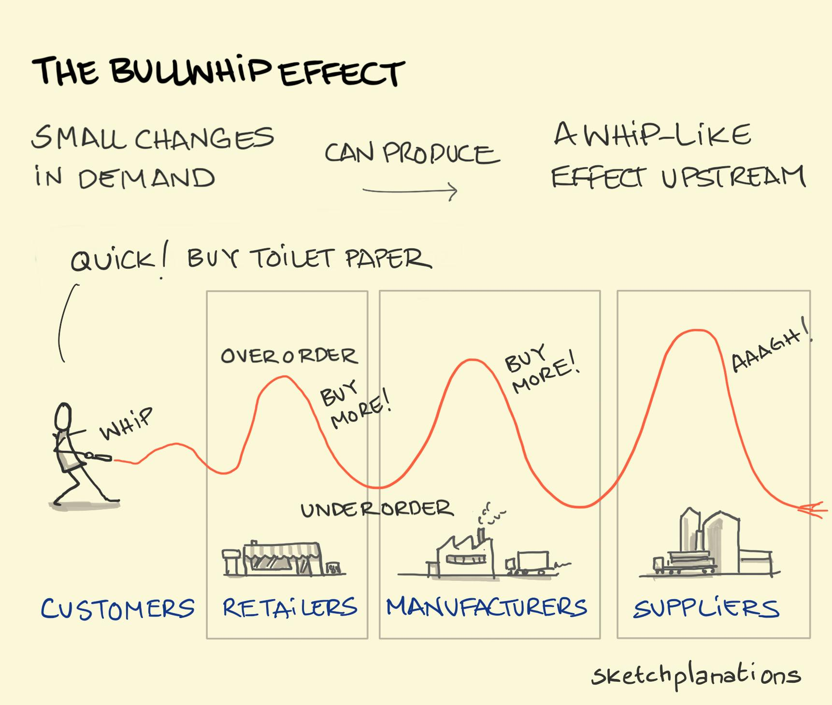


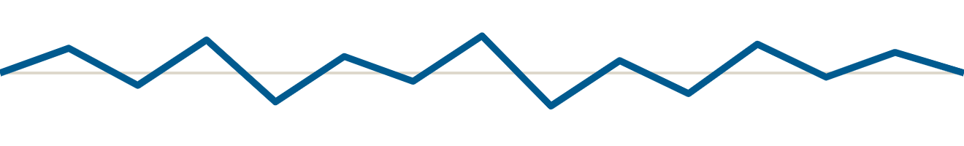
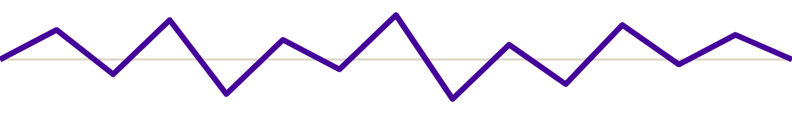
The Bullwhip Effect
Customers
Retailer
Wholesaler
Manufacturer
Small changes in end-customer demand become ever larger swings in orders as they travel upstream.
Each stage sees only the orders of the stage below it, not real demand, and adds its own safety margin.
An information problem that turns into excess stock, idle capacity and stock-outs in operations.
22
Notes:
Students have just tried to explain the data on the previous slide; name the effect now and compare it with their explanations. The chart is illustrative: the same demand pattern amplified at each stage upstream. Classic examples include Procter and Gamble’s nappies, where consumer demand was stable but orders to suppliers swung widely, and toilet roll shortages in early 2020. If time allows, mention the Beer Game as a classroom simulation. Medicine shortages are a sharper example, covered in the research spotlight that follows. Café link: if the café had ordered extra milk every time it ran out, its dairy would see wild swings in orders while customer demand stayed steady. That is the bullwhip in miniature.

Slide 23
Why Does the Bullwhip Happen? Three Competing Explanations
CONTESTED QUESTION
BEHAVIOURAL
RATIONAL-STRUCTURAL
POWER-BASED
Managers misread the system
Sensible choices, distorted signals
Distortion that pays someone
People ignore stock already in the pipeline and over-correct; the Beer Game reproduces this.
Each actor acts rationally, but forecasting from orders, batching, promotions and rationing distort demand.
Actors deliberately control stock and information: quotas, information control, price control.
Fix: better decision rules and training
Fix: share point-of-sale data, VMI, stable pricing
Fix: governance, alliances, regulation; data tools go unused if withholding pays
Sterman (1989)
Lee, Padmanabhan and Whang (1997)
Vann Yaroson et al. (2021; 2023)
23
Notes:
The intellectual centre of the session. The three explanations imply different remedies, so the choice matters for policy. Sterman sees bounded rationality; Lee et al. explicitly argue the bullwhip arises from rational decisions within a distorting structure; my PSC research adds power: some distortion is intended because it benefits the actor who controls stock or information. Walk through the three columns yourself; with a large cohort, the vote in Wooclap 4 does the work of a debate. Pose the question of whether all three can be true at once (they can operate at different tiers), then run Wooclap 4.
MSc DISCUSSION (pairs or think-alone, then take two or three answers): Which explanation is falsifiable? If we gave every actor perfect data and the bullwhip remained, which theory would that support? Note also that the power explanation implies some actors gain from the bullwhip, so the problem may be deliberate rather than an error.

Slide 24
Bullwhip Causes Seen in the UK Medicines Supply Chain
RESEARCH SPOTLIGHT · PHARMACEUTICAL SUPPLY CHAINS
Bullwhip cause (Lee et al.) | What my research found in the PSC | Effect on the chain
Rationing and shortage gaming | Manufacturers impose quota systems; downstream actors panic buy and stockpile | Orders exceed real patient demand
Demand forecast updating | Information control: actors withhold stock and demand information | Upstream reacts to distorted signals
Price fluctuation | Price control and reimbursement pressure; actors chase profit and market share | Orders follow commercial incentives, not patient need
Order batching | Long lead times and complex production (teaching link, not a direct finding) | Lumpy, delayed replenishment
In the PSC, the bullwhip is driven by power-based behaviours, not just poor forecasting.
Sources: Lee, Padmanabhan and Whang (1997); Yaroson et al. (2021); Vann Yaroson et al. (2023)
24
Notes:
This slide connects the classic bullwhip framework to my PSC research. In Vann Yaroson et al. (2023), 23 interviews and a survey of 106 stakeholders identified quota systems, information control and price control as power-based behaviours. Three of these map closely onto Lee et al.’s causes. The order-batching row is a teaching link I am drawing, not a direct research finding: say so explicitly. Key message: in medicines, the amplification comes from actors protecting their own position during shortages.

Slide 25
LIVE CASE · OCTOBER 2026
Predict the Whip: Who Will It Hurt Most?
Households
Buy 9 litres of water each, once.
Supermarkets
See a weekend spike; reorder and rebuild safety stock.
Water bottlers, battery makers
See bigger orders from every retailer; add shifts.
Their suppliers
Plastic bottles, caps, battery cells: see the biggest swing, last.
Real use: unchanged
Orders: up
Orders: up more
Orders: up most?
Order swings get bigger upstream (illustrative)
by Christmas, who is left holding too much stock, and what could stop the whip?
Join: JXRSLXH
A prediction, not data: the stages and swings are illustrative
25
Notes:
About 2 minutes, pairs only, no whole-room debate. Ask them to predict, then take two or three answers. Expected answers: once households have their 9 litres and three days of tins, they stop buying, so in November and December sales fall below normal. Supermarkets that rebuilt safety stock from the spike are left with too much; bottlers and battery makers who added shifts see orders collapse; suppliers of bottles, caps and cells, furthest away, see the biggest and latest swing. What could stop the whip: retailers sharing till data with suppliers so everyone sees that the spike is a one-off; not forecasting from the spike; the government's own advice to buy gradually, which smooths demand; staggering campaign messages. Purchase limits help briefly, but can backfire: rationing signals scarcity and can trigger more shortage gaming. Link forward: the simulation lets you test whether visibility tames the whip.

Slide 26
10-Minute Break
Back at 1:10 for Part 3: trade-offs, risk and sustainability
Notes:
Ten-minute break at the one-hour mark. The question on screen primes Part 3 and the case in Part 4.

Slide 27
Trade-offs in Supply Chains
Typical trade-offs
Cost efficiency
Responsiveness
Lean, low stock, low-cost regions
Short lead times, spare capacity
Lean vs redundant: JIT or buffer stock
Global vs local: low cost or proximity
Resilience
Sustainability
Speed vs emissions: air or sea freight
Buffers, multiple sources, options
Lower carbon, ethical, circular
Cheap vs ethical: lowest bid or audited supplier
Managers must choose deliberately which risks and responsibilities the business is willing to carry.
Sources: León-Bravo and Caniato (2022), cited in Lecture 1; Week 5 lecture
27
Notes:
Ask: which trade-off dominates fast fashion? Pharmaceuticals? Fast fashion tends to prioritise responsiveness and cost; pharmaceuticals prioritise quality and resilience of supply. Then move straight to Wooclap 5: if resilience costs money, who should pay for it?
MSc DISCUSSION (pairs or think-alone, then take two or three answers): Are these really trade-offs? Local sourcing can cut both risk and emissions, so resilience and sustainability can be complements. And whose costs are we trading? 'Cheap vs ethical' often moves cost onto workers in the Global South rather than removing it.

Slide 28
Spare capacity and buffer stock make medicines resilient but cost money. Who should pay?
Join: JXRSLXH
WOOCLAP 5 · VOTE, TALK, REVOTE
≈ 1:15 · 5 minutes
A Manufacturers, as a licence condition
B Wholesalers and pharmacies
C The NHS, through higher prices
D Government, as a public good
Vote, then turn to your neighbour for 60 seconds: will a market ever provide enough resilience on its own? Then vote again.
28
Notes:
Use this right after the trade-offs slide. The argument to draw out: resilience has public-good features. When a shortage is avoided, the benefit spreads across patients, the NHS and competitors, while the cost of spare capacity falls on whoever holds it. So each firm has an incentive to under-invest, especially for low-margin generics (a point in my 2025 evidence to Parliament). Counter-arguments: mandated stock can be inefficient, lock in waste and create moral hazard. Link to policy examples from Redesigning Global Supply Chains: stockholding obligations, due diligence rules and localisation incentives. There is no right answer. Hide results after the first vote, allow 60 seconds of neighbour talk, revote, and comment on any shift; ask one or two students who switched to say why.

Slide 29

Supply Chain Disruptions
Event
War, tariff change, blocked route
Mechanism
Inputs delayed, costs rise, capacity lost
Operations outcome
Output, delivery and margin fall
Event | Exposure | Operational consequence
Suez blockage (2021) | One shipping corridor | Late arrivals, congested ports
Red Sea attacks | Carriers avoid the Suez route | Longer routes, higher freight and insurance
Russia–Ukraine war | Black Sea trade, energy, metals | Input shortages, energy costs
Tariff increases | Imports from specific origins | Higher landed cost, re-sourcing
Tight coupling (little stock or slack between steps) lets a shock spread quickly through the chain (Perrow, 1999).
29
Notes:
Use the event–mechanism–outcome chain to keep discussion analytical. Exposure depends on product, origin, destination and route. Normal Accident Theory: interactive complexity plus tight coupling means shocks interact and spread, for example rerouting delays deplete stock while tariffs constrain alternative sourcing. Check the latest position on Red Sea and Gulf shipping before the lecture. Café link: in the opening puzzle, the delivery van that cannot reach campus is a small-scale version of the same event–mechanism–outcome chain.
MSc DISCUSSION (pairs or think-alone, then take two or three answers): Perrow argues that in tightly coupled, complex systems accidents are 'normal'. If so, is the lean, efficient supply chain itself the source of risk, and is every disruption a design choice we made earlier?

Slide 30
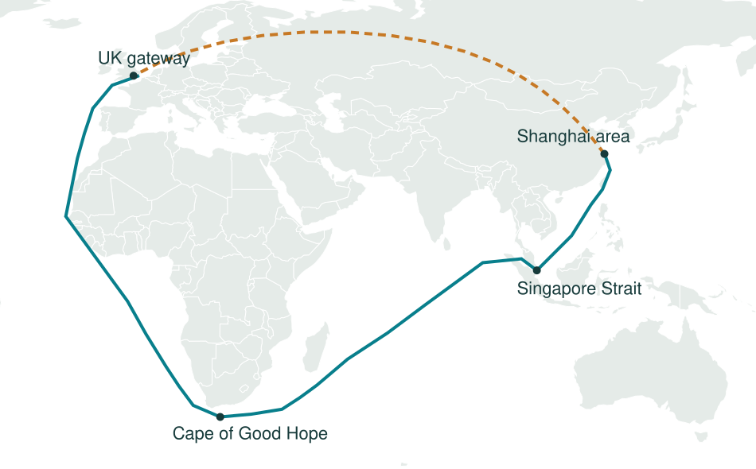
How could the finished phone reach the UK?
Alternative routes after assembly in China
AIR + ROAD
Airport to UK airport,
then truck to a
distribution centre
SEA + ROAD
Port to UK port,
then truck to a
distribution centre
Solid teal: sea via the Cape Dashed amber: illustrative air connection
Schematic corridors, not navigation tracks. Actual routes depend on carriers and conditions.
Notes:
Ask students to weigh delivery speed, freight cost, emissions and reliability. Air and ocean services need road connections at origin and destination. The sea route shown is a schematic teaching corridor around the Cape of Good Hope. An alternative via the Suez Canal may be available depending on carrier and conditions. Do not interpret the air line as an operational flight path. Upstream: cobalt can travel by road to export gateways, then by sea to processing; component suppliers can use air or sea links to assembly, depending on urgency and requirements. Sources: Hapag-Lloyd NE3 Cape network, https://www.hapag-lloyd.com/en/services-information/routes-trades/gemini-cogh/route-finder.html/asia/north_europe/NE3.html ; DHL Multimodal OceanExpress, https://go.freightforwarding.dhl.com/dhl-multimodal-oceanexpress . These establish possible logistics corridors, not the route of a particular phone shipment.

Slide 31
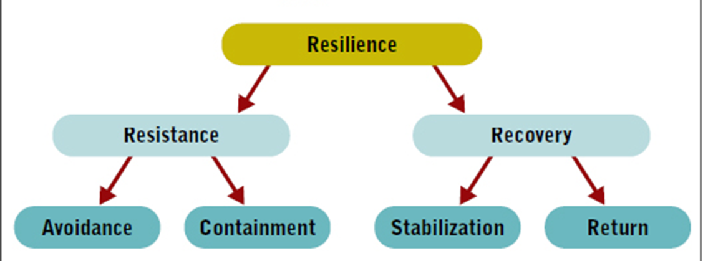
Supply chain resilience: definition and response
“The adaptive capability of a supply chain to prepare for and/or respond to
disruptions, to make a timely and cost-effective recovery, and therefore progress to
a post-disruption state of operations – ideally, a better state than prior to the disruption”
Tukamuhabwa et al. (2015, p. 5599)
What this means
Take a whole-system perspective.
Accept that disturbances happen.
Adapt to changing circumstances.
Figure: Sodhi and Chopra (2014), as cited in the supplied lecture.
Notes:
Full definition retained from the user-supplied slide, with corrected page citation. Tukamuhabwa, B.R., Stevenson, M., Busby, J. and Zorzini, M. (2015). Supply chain resilience: definition, review and theoretical foundations for further study. International Journal of Production Research, 53(18), 5592–5623. Quote on p. 5599. Figure retained unchanged from the user-supplied lecture, which attributes it to Sodhi and Chopra (2014). Full bibliographic details for the figure were not provided. Resistance concerns avoiding or containing disruption impact. Recovery concerns stabilising operations and returning to an operating state. Adaptation means this can be an improved state, rather than an exact return to the past.
MSc DISCUSSION (pairs or think-alone, then take two or three answers): Resilience 'to a better state' for whom? A focal firm can look resilient by pushing stock and risk onto smaller suppliers. Should resilience be measured at firm level or at chain level, and could a resilient firm sit inside a fragile chain?

Slide 32
Capabilities that support supply chain resilience
What can organisations develop before, during and after disruption?
Flexibility
Adjust suppliers, routes, processes or volumes as needs and conditions change,
with minimal effort and delay.
Redundancy
Hold safety stock, maintain alternative suppliers and reserve spare capacity
to keep operating and buy time for recovery.
Information sharing,
collaboration and IT
Exchange timely information and coordinate decisions across partners.
Use technology to support joint planning and risk mitigation.
Trust
Build confidence in partners’ reliability, competence and commitments
so they can cooperate during disruption.
Velocity
Detect threats and act quickly. Shorten response, replenishment
and recovery times.
Visibility
See inventory, demand, capacity, shipment status and emerging risks
across supplier tiers and downstream partners.
Cost-effectiveness
Evaluate the cost of resilience measures against the disruption losses
they may avoid and the service they help maintain.
Adapted from Tukamuhabwa et al. (2015). Cost-effectiveness is an evaluation criterion across all capabilities.
Notes:
All seven dimensions from the supplied table retained, with fuller explanations and minor conceptual corrections. Redundancy means spare resources and options; it can increase holding or capacity costs. Velocity is broader than threat detection and includes response and recovery speed. Visibility applies across supply chains rather than only pharmaceuticals. Trust does not remove the need for verification and governance. Cost-effectiveness evaluates the portfolio of resilience strategies rather than necessarily being a capability itself. Source: Tukamuhabwa, B.R., Stevenson, M., Busby, J. and Zorzini, M. (2015). Supply chain resilience: definition, review and theoretical foundations for further study. International Journal of Production Research, 53(18), 5592–5623. Based on the supplied teaching table, not claimed as a verbatim taxonomy from the article.

Slide 33
Building Supply Chain Resilience
The ability to prepare for disruption, respond and recover, while maintaining essential operations (Ponomarov and Holcomb, 2009; Tukamuhabwa et al. 2015).
Robustness
Redundancy
Reduce the chance of disruption: supplier audits, quality approval
Deliberate slack: safety stock, dual sourcing, back-up sites
Flexibility and agility
Visibility and collaboration
Reconfigure fast: alternative routes, suppliers and production sites
See problems early across tiers and respond together
Each has a cost: stock ties up cash, new suppliers need qualifying, faster transport adds cost and emissions.
Sources: Christopher and Peck (2004); Ponomarov and Holcomb (2009)
33
Notes:
These levers reappear as funding choices in Wooclap 6. Emphasise matching the lever to the vulnerability: buffers absorb short delays but not prolonged ones; a second supplier helps only if it does not share the same upstream dependency; visibility helps only if someone has the authority and options to act.

Slide 34
RESILIENCE IN REAL LIFE
Red Sea 2024: Same Shock, Different Outcomes
The shock: Houthi attacks on ships from late 2023. Suez Canal traffic fell about 50% as carriers rerouted around the Cape of Good Hope, adding time and cost to every Asia–Europe shipment.
Inditex (Zara)
Built in advance: 57% of production capacity in Spain, Portugal, Morocco and Turkey (2018), reached by road, not the Suez route.
Senses and seizes: daily store data; small, frequent orders; new styles in stores within weeks.
Impact: about a one-week average delay; “operations have not been significantly impacted”.
Result: sales up 11% in Feb–Mar 2024, outpacing H&M.
H&M
Built in advance: long-haul supply, mainly from Asia, designed for low cost.
Senses and seizes: asked suppliers to ship earlier; moved campaign dates; expanding nearshoring.
Impact: delays of up to about two weeks in some markets; spring/summer campaigns postponed.
Result: Q1 2024 sales dipped slightly (profit rose on cost cuts).
React: Was Zara resilient, or lucky that this shock hit sea routes it relied on less?
Its proximity network costs more in normal years. When is that premium a competitive advantage, and when is it waste?
Sources: Fortune (15 Mar 2024); Retail Gazette (Mar 2024); The MDS (2019, 2018 supplier data); IMF data cited by Fortune.
34
Notes:
About 3 minutes. A recent disruption that hit two direct competitors differently. The shock: from late 2023 Houthi attacks on shipping in the Red Sea pushed carriers to avoid the Suez Canal and sail around the Cape of Good Hope; IMF data cited by Fortune showed Suez volumes down about 50% year on year. Inditex, owner of Zara: for decades it has kept a large share of production close to Spain. In 2018 about 57% of its production capacity sat in Spain, Portugal, Morocco and Turkey, supplied by road (The MDS; the share has fallen somewhat since as Inditex has grown in Asia). In March 2024 it reported an average delay of about one week and said its operations had not been significantly impacted; sales from 1 February to 11 March 2024 were up 11%, and full-year sales to January 2024 rose 10.4% to €36 billion, outpacing H&M (Fortune, 15 March 2024). Caveat for students: the annual results cover a whole year, so not all of that is the Red Sea. H&M: sources mainly from Asia for low cost. It postponed some spring/summer campaigns, with delays of up to about two weeks in some markets; it asked suppliers to ship earlier and is expanding nearshoring. CEO Daniel Ervér said the effect on availability was minor. Q1 2024 sales dipped slightly while profit rose on cost cuts (Retail Gazette, March 2024). React: was Zara resilient or lucky? A proximity network costs more every year, and pays off only when long-haul routes fail. Would it help in a European energy crisis or a strike at Spanish ports? This sets up the theory on the next slide.

Slide 35
RESILIENCE IN REAL LIFE · THEORY
Three Lenses: Why Zara Coped Better
Resource-based view
Barney (1991)
Resilience as a resource: a dense supplier network close to home, built over decades.
Red Sea: VRIN: valuable when sea routes fail, rare among fast-fashion rivals, slow to imitate. H&M is only now nearshoring.
So what: Static and costly: the resource earns its premium only when the shock hits Asia routes.
Dynamic capabilities
Teece, Pisano and Shuen (1997); Teece (2007)
Advantage from sensing, seizing and reconfiguring faster than rivals.
Red Sea: Both firms sensed the shock. Zara could seize faster: daily store data, small batches, options a truck ride away. H&M reconfigured slowly: earlier shipping, new campaign dates, nearshoring.
So what: Capabilities depend on resources: you can only seize options you have built.
Complex adaptive systems
Choi, Dooley and Rungtusanatham (2001)
No one controls the network. System behaviour emerges from many firms adapting at once.
Red Sea: Thousands of shippers rerouted and shipped early. Ships bunched up at Singapore, freight rates rose and peak season arrived early (June 2024): nobody planned it.
So what: Your resilience depends on what everyone else does; you can adapt, not control.
Pairs, 2 minutes: H&M asked suppliers to ship early. If every retailer does the same, what happens, and which lens explains it?
Then: is resilience still a competitive advantage once rivals can copy it?
Sources: Barney (1991); Teece, Pisano and Shuen (1997); Teece (2007); Choi, Dooley and Rungtusanatham (2001); Bloomberg via gCaptain (21 Jun 2024)
35
Notes:
About 4 minutes: 1 minute to introduce the lenses, 2 minutes in pairs, 1 minute to take answers. Resource-based view (Barney, 1991): competitive advantage comes from resources that are valuable, rare, inimitable and non-substitutable. Inditex's proximity network is a resilience resource built over decades: valuable when long-haul sea routes fail, rare among low-cost fashion rivals, and slow to imitate because it takes years to build supplier clusters and logistics around them. H&M announcing more nearshoring in 2024 is evidence that it is trying to imitate. The critical point: the resource is costly in normal years and only valuable for some kinds of shock, so resilience is an advantage that must be paid for in advance. Dynamic capabilities (Teece, Pisano and Shuen, 1997; Teece, 2007): advantage from sensing threats and opportunities, seizing them, and reconfiguring resources. Both firms sensed the Red Sea shock quickly. Zara could seize faster because of daily store data, small and frequent orders, and production options a truck ride away; H&M's responses (asking suppliers to ship earlier, moving campaign launch dates, expanding nearshoring) are sensing and reconfiguring, but slower and from a weaker resource base. Lesson: dynamic capabilities and resources are complements; you can only seize options you have already built. Complex adaptive systems (Choi, Dooley and Rungtusanatham, 2001): supply networks are made of many autonomous firms adapting to each other, so system behaviour emerges and no one controls it. In 2024 thousands of shippers rerouted around the Cape and shipped early. Ships stopped calling at Middle East ports and bunched up at Singapore, cargo stayed in port longer, freight rates rose and the peak shipping season came forward (Bloomberg via gCaptain, 21 June 2024). Each firm acted sensibly; the congestion was an emergent result nobody planned. Answer to the pair question: if every retailer ships early, the extra early demand for ships pushes freight rates and congestion up, so shipping early stops working; that is emergence (CAS), and it is also a bullwhip in shipping capacity. On imitation: once rivals copy a proximity network it stops being rare, so advantage must come from dynamic capabilities, the ability to keep reconfiguring. Full references: Barney, J. (1991) 'Firm resources and sustained competitive advantage', Journal of Management, 17(1), 99–120. Choi, T.Y., Dooley, K.J. and Rungtusanatham, M. (2001) 'Supply networks and complex adaptive systems: control versus emergence', Journal of Operations Management, 19(3), 351–366. Teece, D.J., Pisano, G. and Shuen, A. (1997) 'Dynamic capabilities and strategic management', Strategic Management Journal, 18(7), 509–533. Teece, D.J. (2007) 'Explicating dynamic capabilities', Strategic Management Journal, 28(13), 1319–1350.

Slide 36
Defining Sustainable Supply Chains
The management of material, information and capital flows as well as cooperation among companies along the supply chain while taking goals from all three dimensions of sustainable development — economic, environmental and social — into account, which are derived from customer and stakeholder requirements (Seuring and Muller, 2008).
The management of environmental, social and economic impacts and the encouragements of good governance practices, throughout the lifecycles of goods and services" (UN Global Compact, 2015).

Slide 37
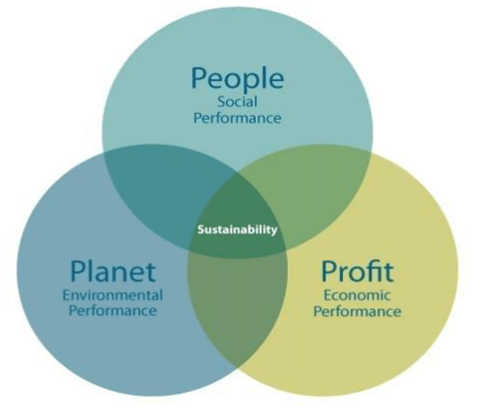
Supply chain sustainability: the four Ps
Balance environmental, social and economic outcomes, guided by purpose
PLANET
Environmental impact
Emissions, energy and water use,
waste, biodiversity and sourcing.
PEOPLE
Impact on workers and communities
Safe work, fair treatment, human rights
and customer safety across the chain.
PROFIT
Long-term economic viability
Productivity, total cost, resilient suppliers
and investment in sustainable operations.
PURPOSE
Direction, values and accountability
Purpose guides decisions
across all three outcomes
Clear commitments, ethical leadership
and responsible purchasing decisions.
Triple bottom line: people, planet and profit. The 4P model adds purpose as a guiding lens.
Notes:
Merged from the two supplied slides. Triple bottom line diagram retained from the supplied image. The 4P visual in the source slide is attributed to Kjaer Global; the original publication has not been independently verified. Purpose is presented as a guiding lens and not as an exact synonym for governance. Governance includes the arrangements for oversight, accountability and translating commitments into decisions. Profit is broader than green finance: financial viability, productivity, total cost and long-term investment matter; sustainability-linked finance is one possible enabler. Ask: would you choose a cheaper supplier if its labour conditions are poor? Which of the four Ps helps explain your answer?
MSc DISCUSSION (pairs or think-alone, then take two or three answers): Can a supply chain be sustainable if its product is not? A perfectly audited fast-fashion chain still produces garments worn a handful of times. Is sustainability a property of the supply chain or of the business model?

Slide 38
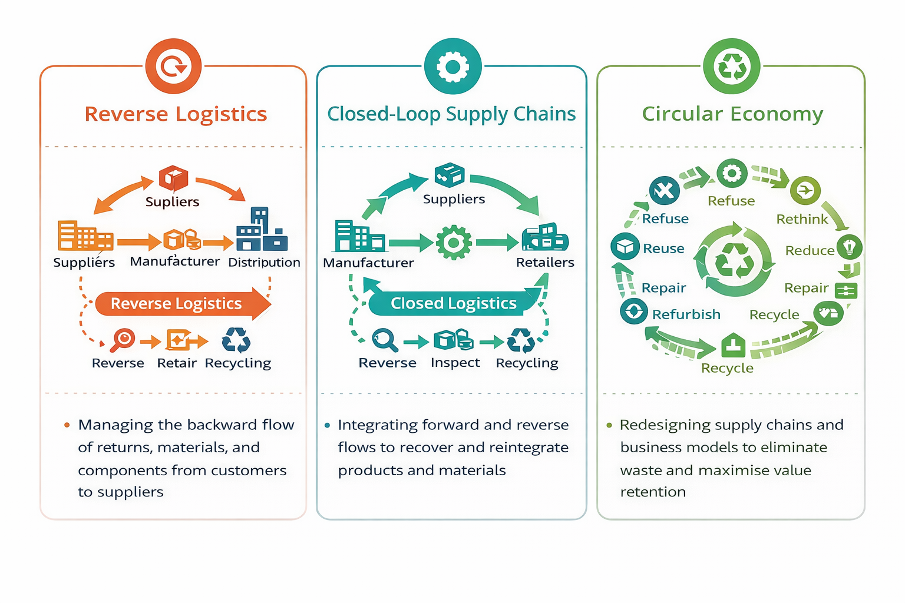
Sustainable Strategies in Supply Chains

Slide 39
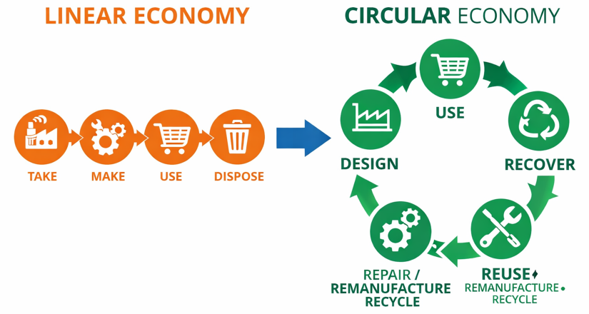
Circular supply chains: the 10R strategies
Keep products, components and materials in use for longer
R0
Refuse
Avoid unnecessary products
R1
Rethink
Share or offer products as a service
R2
Reduce
Use fewer materials and less energy
R3
Reuse
Use again or resell
R4
Repair
Fix faults and extend useful life
R5
Refurbish
Restore and update an older product
R6
Remanufacture
Rebuild with recovered components
Supply chain implications
R7
Repurpose
Give products or parts a new function
R8
Recycle
Recover materials for processing
Design out unnecessary inputs.
Organise collection and reverse logistics.
Support repair, resale and parts recovery.
R9
Recover
Recover energy from residual waste
Prioritise prevention and life extension before material or energy recovery.
10R hierarchy: Potting et al. (2017). Circular economy: Geissdoerfer et al. (2017).
Notes:
10R reference: Potting, J., Hekkert, M., Worrell, E. and Hanemaaijer, A. (2017). Circular Economy: Measuring innovation in product chains. PBL Netherlands Environmental Assessment Agency, report 2455. https://www.pbl.nl/en/publications/circular-economy-measuring-innovation-in-product-chains . Circular economy reference: Geissdoerfer, M., Savaget, P., Bocken, N.M.P. and Hultink, E.J. (2017). The Circular Economy – A new sustainability paradigm? Journal of Cleaner Production, 143, 757–768. https://doi.org/10.1016/j.jclepro.2016.12.048 . Supplied illustration retained as a conceptual comparison; its original image source is not established. Recover is energy recovery, typically from incineration with energy capture, and is the lowest-priority strategy in this hierarchy, rather than equivalent to keeping materials circulating. R0–R2 concern smarter use and manufacture, R3–R7 extend product and component life, R8–R9 concern residual materials. This priority is a starting point, with context-specific life-cycle assessment needed. Definitions paraphrased; no direct quote reproduced. Supply chain implications: refuse unnecessary SKUs, rethink sharing and service contracts, reduce input and transport waste, reuse through resale and reverse logistics, repair with spare parts and modular design, refurbish through inspection and upgrading, remanufacture through component recovery and supplier coordination, repurpose through alternative-use markets, recycle through separation and processing, recover residual energy where appropriate. Ask: which R retains most value for a damaged mobile phone?
MSc DISCUSSION (pairs or think-alone, then take two or three answers): Recycling sits near the bottom of the 10R ladder, yet it gets most of the attention. Why do firms prefer the lower Rs? Consider who captures value in each R: refuse and rethink threaten sales volume.

Slide 40
You run sustainability for a UK fashion brand. You can fund one change. Which cuts its footprint most?
Join: JXRSLXH
WOOCLAP 6 · POLL + ONE SENTENCE
≈ 1:30 · 5 minutes
A Switch from air freight to sea freight
B Nearshore production to Europe
C Switch to recycled polyester
D Design clothes to last, and sell fewer of them
Vote, then write one sentence in Wooclap: which option would your finance director block, and why? No discussion needed.
40
Notes:
About 5 minutes. Wooclap set-up: one poll (A to D) and one open question: 'Which option would your finance director block, and why?' Clothing is something every student buys, so everyone has a view. Let them vote before showing the next slide. Expect many votes for A and B, because transport and distance are what people picture when they think of a supply chain's footprint. The reveal on the next slide: in the McKinsey and Global Fashion Agenda analysis, transport is only about 3% of fashion's emissions; materials and production are about 70% and consumer use (washing, drying) about 20%. So A and B attack the smallest slice; C helps with materials but has its own problems; D is the only option that removes whole garments, and with them all of their production emissions. The finance director answers are the point: D threatens a volume business model, which is why it is rarely chosen. Read out three or four.

Slide 41
WOOCLAP 6 · THE REVEAL
Where a Garment’s Emissions Come From
SHARE OF THE FASHION INDUSTRY’S GREENHOUSE GAS EMISSIONS
WHAT EACH OPTION TOUCHES
A Air to sea: big cut per item, but most clothing already ships by sea.
B Nearshore: saves transport; helps more if the new factories run on cleaner energy.
C Recycled polyester: trims the materials slice, but often from bottles, not old clothes, and it still sheds microfibres.
D Fewer, longer-lasting clothes: removes whole garments, and all their production emissions.
Materials and production
≈70% fibres to finished fabric
Consumer use
≈20% washing and drying at home
Transport
≈3% options A and B act here
Retail and marketing
≈3%
End of life
≈3%
Distance is the smallest slice. The biggest cut, making and selling less, attacks the volume business model.
So is sustainability decided in the supply chain, or in the business model?
Source: McKinsey & Company and Global Fashion Agenda (2020) Fashion on Climate; figures for 2018, rounded.
41
Notes:
About 3 minutes. Show the Wooclap results first, then this slide. In McKinsey and Global Fashion Agenda's Fashion on Climate (2020), the fashion industry emitted about 2.1 billion tonnes of greenhouse gases in 2018, about 4% of the global total. Roughly 70% came from materials and production (raw materials 38%, then yarn, fabric preparation, wet processing and drying, and cutting), about 20% from consumer use, and only about 3% each from transport, retail and end of life. A: air freight emits far more per item than sea, so cutting it matters for the few lines flown in, but most clothing already moves by sea. B: nearshoring saves part of a 3% slice; its bigger effect depends on the energy mix of the new factories. Link back to The Changing Landscape slide: the claim that regionalising lowers emissions needs this caveat. C: recycled polyester reduces virgin material use, but most of it comes from plastic bottles rather than old clothes (taking bottles out of a closed bottle-to-bottle loop), and synthetic fibres still shed microplastics. D: the largest cut, because every garment not made avoids its whole production footprint; it is the 'refuse, rethink, reduce' end of the 10R ladder (slide 37). The critical question: if the most effective option threatens the volume business model, can supply chain managers deliver sustainability at all, or is it a strategy and business-model decision? Use the finance director answers from Wooclap here.

Slide 42
Digital Tools That Connect Operations and Supply Chains
Function | Technologies | What it does for operations
Sense | IoT, RFID, computer vision | Creates visibility of stock and assets
Connect | ERP, cloud platforms, blockchain | Shares data across firms
Analyse | Analytics, machine learning, GenAI | Forecasts demand and predicts risk
Simulate | Digital twins | Tests disruption scenarios before they happen
Decide and act | Control towers, agentic AI | Flags exceptions and coordinates response
Execute | Robotics, automation | Carries out physical work in plants and warehouses
Technology reduces the bullwhip and speeds recovery, but only with good data, shared incentives and people able to act.
Source: Week 5, Digital Supply-Network Framework
42
Notes:
A compressed version of the digital supply-network framework from Week 5. Keep this brief: the point is that digital tools mainly address the information flow, which is where the bullwhip and slow disruption responses start. Then move to the case.
MSc DISCUSSION (pairs or think-alone, then take two or three answers): Visibility for whom? Sharing data shifts power: the actor who sees the whole chain can squeeze the rest. Link to the power-based bullwhip: would wholesalers in your research share stock data with manufacturers who impose quotas?

Slide 43
The Changing Landscape: Regionalisation and Deglobalisation
THEN
Global chains designed for cost efficiency and scale
NOW
Networks redesigned for risk, sustainability and uncertainty
DEGLOBALISATION: HOW FIRMS REBALANCE
Nearshoring: make closer to the customer
Multi-regional networks: a hub in each region
Redundancy: a second supplier, spare stock
Strategic autonomy: control of critical goods
WHY REGIONALISE?
Resilience to disruption
Sustainability and lower transport emissions
Policy incentives
Geopolitical risk
Not the end of globalisation: a rebalancing between global reach and regional security.
Source: module material
43
Notes:
About 3 minutes. The landscape has shifted. For decades global supply chains were designed for cost efficiency and scale: make where it is cheapest, ship it worldwide, hold little stock. Over the last decade, after the pandemic, the Suez blockage, wars and tariffs, firms have been redesigning networks to account for risk, sustainability and uncertainty. The result is not the end of globalisation: supply chains are becoming regionalised but interconnected. Firms rebalance global and regional sourcing through nearshoring, multi-regional networks with a hub in each region, deliberate redundancy such as a second supplier or buffer stock, and strategic autonomy over critical goods such as chips, energy and medicines. Why: resilience, sustainability and lower transport emissions, policy incentives, and geopolitical risk. Tie back to examples students have already seen: the chair made in Poland for the UK market; the hoodie in the simulation made in Turkey, 10 days by road; Morocco halting sardine exports to protect its home market; export bans spreading medicine shortages across borders. Link back to the trade-offs slide: regionalising buys resilience but usually costs more. Ask: would you pay 10% more for a hoodie made in Europe?
MSc DISCUSSION (pairs or think-alone, then take two or three answers): Does regionalisation reduce risk or concentrate it? Three regional blocs may be less diverse than one global network. And who loses when production comes home: what happens to the economies that built their growth on export manufacturing?

Slide 44
What Is Reshaping Supply Chains?
DRIVERS AND WHAT THEY DEMAND OF SUPPLY CHAINS
POLICY NOW SHAPES THE CHAIN, NOT JUST MARKETS
Carbon border adjustment mechanisms
Due diligence and sustainability disclosure rules
Food security and localisation incentives
Industrial decarbonisation strategies
Regulation and policy
Stricter compliance and reporting
Changing consumer demand
Ethical and transparent sourcing
Climate and resource risk
Resilient, low-carbon operations
Geopolitical uncertainty
Regional, redundant networks
INDUSTRY 4.0 → INDUSTRY 5.0
From automation, digitalisation, efficiency
to human-centric, sustainable, resilient
Human–AI collaboration: cobots, digital twins for network planning, AI-assisted decisions, cyber-physical production, sustainable manufacturing
Technology
Digital visibility and innovation
Circular economy
Reuse, repair and reverse flows
Think: which driver will matter most for the supply chain you hope to work in, and why?
Sources: Ivanov (2023); Modgil et al. (2025); Vann Yaroson et al. (2025)
44
Notes:
About 3 minutes. Six forces are reshaping supply chains, and each makes a demand of them. Regulation and policy demand stricter compliance and reporting; changing consumer demand pushes ethical and transparent sourcing; climate and resource risk call for resilient, low-carbon operations; geopolitical uncertainty drives regional, redundant networks; technology enables digital visibility and innovation, as in the simulation; the circular economy adds reuse, repair and reverse flows. Policy now shapes supply chains, not just market forces: carbon border adjustment mechanisms put a price on carbon in imports; due diligence and sustainability disclosure rules make firms answer for their suppliers; food security policies and localisation incentives pull production home; industrial decarbonisation strategies change how and where things are made. Industry 5.0 is an evolution beyond Industry 4.0. Industry 4.0 emphasised automation, digitalisation and efficiency; Industry 5.0 emphasises human-centric production, sustainability and resilience (Ivanov, 2023; Modgil et al., 2025). In practice that means human–AI collaboration: cobots working alongside people, digital twins for network planning, AI-assisted decision-making, cyber-physical production systems and integrated sustainable manufacturing (Vann Yaroson et al., 2025). Close by asking students to think, not discuss aloud: which driver will matter most in the supply chain they hope to work in. This leads into the case.
MSc DISCUSSION (pairs or think-alone, then take two or three answers): Is Industry 5.0 a genuine new paradigm or a policy label, coined by the European Commission in 2021, for what good operations management already aimed at? What evidence would show the difference? And can 'human-centric' survive the business case for AI-driven automation?

Slide 45
Why Supply Chains Matter for Operations Management
1
Most cost and performance sit outside the firm’s walls. Bought-in inputs and logistics drive much of what customers experience.
2
It shapes competitiveness, not just efficiency. Understanding suppliers’ suppliers and customers’ customers explains why immediate partners behave as they do.
3
Not all links matter equally. Some operations have outsized influence on what the end customer values; managers must find them.
4
It exposes long-term structural risk. Chains evolve: a link that once seemed secure can be bypassed, as retailers were by direct online sales.
5
It underpins the biggest strategic decisions. Network configuration, location and capacity are hard to reverse and set the context for everything else.
45
Notes:
Five reasons drawn from the Week 5 material. Link back to Wooclap 2: whichever objective the class chose, point 1 explains why suppliers matter so much. Point 5 previews Part 2.

Slide 46
Key Takeaways
OM and SCM are one system
Decisions are strategic
An operation performs only as well as the chain that feeds and serves it.
Configuration, location, sourcing and capacity lock in cost and risk for years.
Failure can be rational
Trade-offs are unavoidable
The bullwhip has competing explanations; if power drives it, data sharing alone will not fix it.
Resilience costs someone; deciding who pays is a strategic and policy choice.
46
Notes:
Summarise in under two minutes, then run the exit ticket.

Slide 47
References
ASCM (2022) SCOR Digital Standard. Association for Supply Chain Management.
Christopher, M. (1992) Logistics and Supply Chain Management. London: Pitman.
Christopher, M. and Peck, H. (2004) ‘Building the resilient supply chain’, IJLM, 15(2), pp. 1–14.
Fisher, M.L. (1997) ‘What is the right supply chain for your product?’, Harvard Business Review, 75(2), pp. 105–116.
Lee, H.L., Padmanabhan, V. and Whang, S. (1997) ‘The bullwhip effect in supply chains’, Sloan Management Review, 38(3), pp. 93–102.
León-Bravo, V. and Caniato, F. (2022), as cited in Lecture 1.
Mentzer, J.T. et al. (2001) ‘Defining supply chain management’, Journal of Business Logistics, 22(2), pp. 1–25.
Perrow, C. (1999) Normal Accidents. Princeton: Princeton University Press.
Ponomarov, S.Y. and Holcomb, M.C. (2009) ‘Understanding the concept of supply chain resilience’, IJLM, 20(1), pp. 124–143.
Seuring, S. and Müller, M. (2008) ‘From a literature review to a conceptual framework for sustainable supply chain management’, Journal of Cleaner Production, 16(15), pp. 1699–1710.
Slack, N., Brandon-Jones, A. and Burgess, N. (2022) Operations Management. 10th edn. Harlow: Pearson.
Sterman, J.D. (1989) ‘Modeling managerial behavior: misperceptions of feedback in a dynamic decision making experiment’, Management Science, 35(3), pp. 321–339.
Teece, D.J. (2007) ‘Explicating dynamic capabilities’, Strategic Management Journal, 28(13), pp. 1319–1350.
47
Notes:
Full references for the sources cited on the slides. Complete the León-Bravo and Caniato entry from the Lecture 1 reading list.

Slide 48
Thank You
Any questions?
Dr Emilia Vann Yaroson
e.v.yaroson@sheffield.ac.uk
Notes:
Close and invite questions.

